Slide 1
2018-2019
Student Meal Copay Charge Policy
Provided by the LAUSD Food Services Division
06/12/18
Notes:
Welcome to the 2018-2019 Student Meal Copay Charge Policy Training.

Slide 2
Overview
This training will provide attendees with the knowledge to understand the student meal copay charge policy and requirements. This training will address the following areas:
Student Copay
Student Meal Charge Policy
Student Account Balance Notification Letters and Policy
Instructions to print Account Balance Notification Letters
Notes:
Food Service Division overview :
This training will provide attendees with the knowledge to understand the students meal co-pay charge policy and requirements. This training will address the following areas:
Student Copay
Student Meal Charge Policy
Student Account Balance Notification Letters and Policy
Instructions to print Account Balance Notification Letter
READ SLIDE:

Slide 3
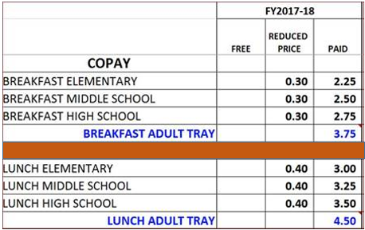
Students Copay 2018-2019
For 2018-2019 student copay will not change. The copay will remain as follows:
Notes:
READ SLIDE:
Students Copay 2018-2019,
The student copay will not change this year. The copay will remain as follows:
Read Chart

Slide 4
Students Meal Charge Policy
Los Angeles Unified School District BUL-4888.1 is the Student Meal Charges Policy implemented 2017-2018 school year.
Notes:
Lets review the Students Meal Charge Policy, Los Angeles Unified School District BUL-4888.1 is the Student Meal Charges Policy implemented 2017-2018 school year. On our next screen we will review the bulletin.

Slide 5
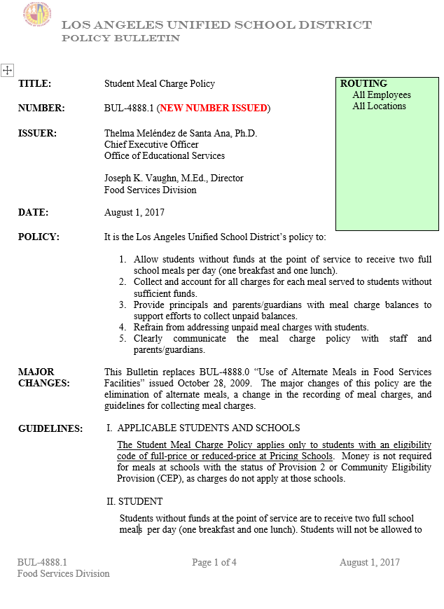
It is the Los Angeles Unified School District’s Policy to:
Allow students without funds at the point of service to receive two full school meals per day (one breakfast and one lunch).
Collect and account for all charges for each meal served to students without sufficient funds.
Provide principals and parents/guardians with meal charge balances to support efforts to collect unpaid balances.
Refrain from addressing unpaid meals charges with students.
Clearly communicate the meal chare policy with staff and parents/guardians
Notes:
Bulletin 4888.1 is 4 pages and is available in Food Services Web Page. Today we will focus on section that states the policy.
Read: section “It is the Los Angeles Unified School District’s policy”

Slide 6
Students Account Balance Letters
Account Balance Letters are generated through CMS One Source System. Letters are generated monthly by the Food Services Manager or designee.
SOP #POS 6.3 Account Balance Notifications Letter
Account balance letters can be printed for:
All students
Individual students
Student eligibility groups
Distribute account balance letters by homeroom. Provide to the student to give to the parent. It is the student Responsibility to deliver letter to the parent/guardian.
Notes:
Read: The Account Balance Letters are to be generated through the CMS One Source System. These letters must be generated Monthly by the Food Services Manager (FSM)or designated employee and distributed by homeroom. Account Balance Letters should be printed for all customers (students), but can be printed only for individual students or student eligibility groups. When issuing the balance letter food services manager or designated employee must follow SOP #POS 6.3 Account Balance Notifications Letter
SOP #POS 6.3 Account Balance Notifications Letter
Negative Balance Letter –Paid- Manager
Negative Balance Letter –Reduce-Principal
Manager Letter
Administrator Letter

Slide 7
Students Account Balance Letters
Beginning August 2018 Account balance letter will be generated according to the balance amount due.
Negative Balance Letters – Manager
For full price and reduced eligible student if the account balance is less than - $20.00
Negative Balance Letters – Principal
For full price and reduced eligible student if the account balance is more than - $20.00
Notes:
Read: The Account Balance Letters are to be generated through the CMS One Source System. These letters must be generated Monthly by the Food Services Manager (FSM)or designated employee and distributed by homeroom. Account Balance Letters should be printed for all customers (students), but can be printed only for individual students or student eligibility groups. When issuing the balance letter food services manager or designated employee must follow SOP #POS 6.3 Account Balance Notifications Letter
SOP #POS 6.3 Account Balance Notifications Letter
Negative Balance Letter –Paid- Manager
Negative Balance Letter –Reduce-Principal
Manager Letter
Administrator Letter

Slide 8
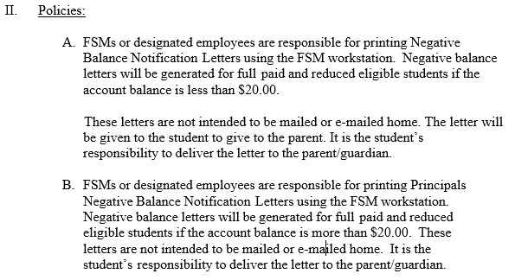
SOP # POS 6.3
Notes:
Sop #POS 6.3 is also 4 pages and is available in Food Services Web Page. Today we will focus on section that states the policy for Negative Balance letter Printing and distribution.
Click
Read: section II Policies

Slide 9
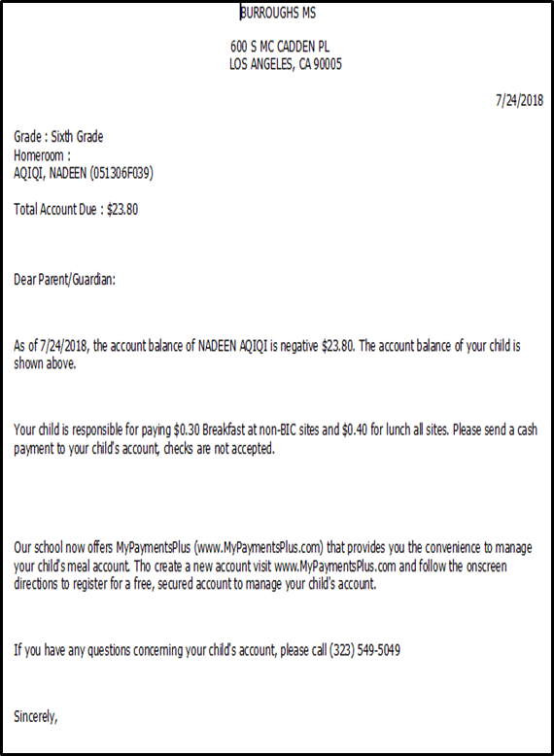
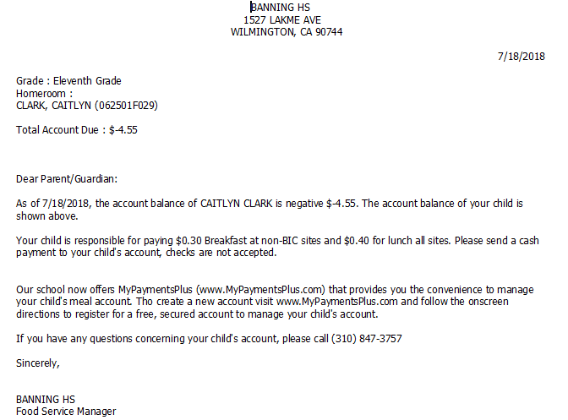
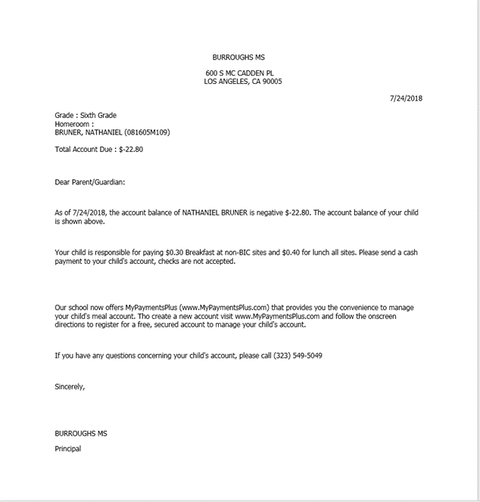
Negative Balance Letter-Reduce
Manager’s letter
Principal’s letter
Notes:
Negative Balance Letter – For reduce eligibility we have two Letters:
Managers Letter- For Reduce accounts that are negative Less than - $20.00
Principal Letter- For Full Pay accounts that are negative over -$20.00

Slide 10
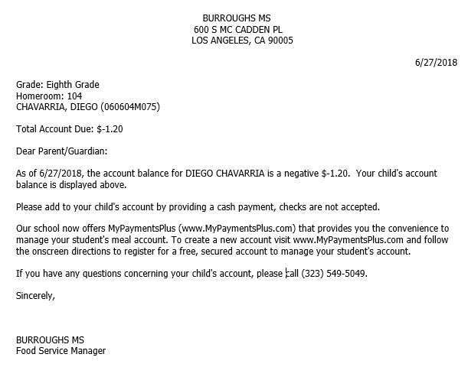
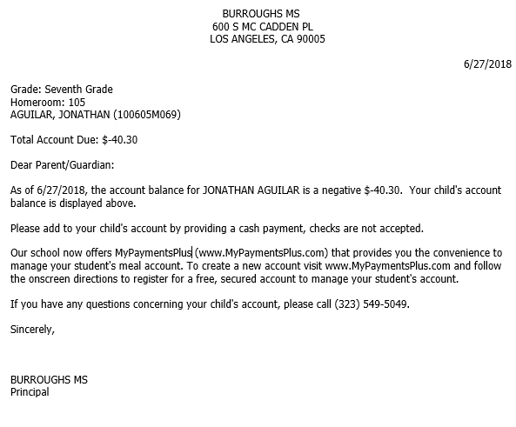
Negative Balance Letter – Full Paid
Manager’s letter
Principal’s letter
Notes:
Negative Balance Letter – For full pay we have two Letters; A sample of the letters is included in the handout we provided.
Managers Letter- For Full Pay accounts that are negative Less than - $20.00
Principal Letter- For Full Pay accounts that are negative over - $20.00

Slide 11
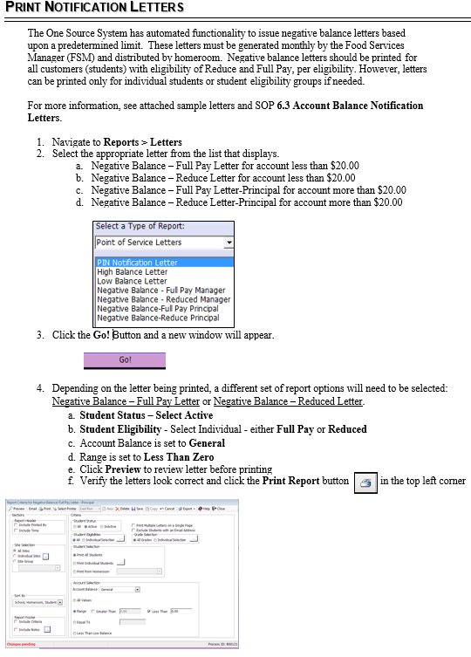
Print Notification Letter Instructions
Notes:
We have Instruction on how to print Notification Letters, you have a copy of these instruction in the handout we provided. Instruction will be posted in the Food Services Web Page. On the next few screens we have step by step instruction that we will review now.
Next screen

Slide 12
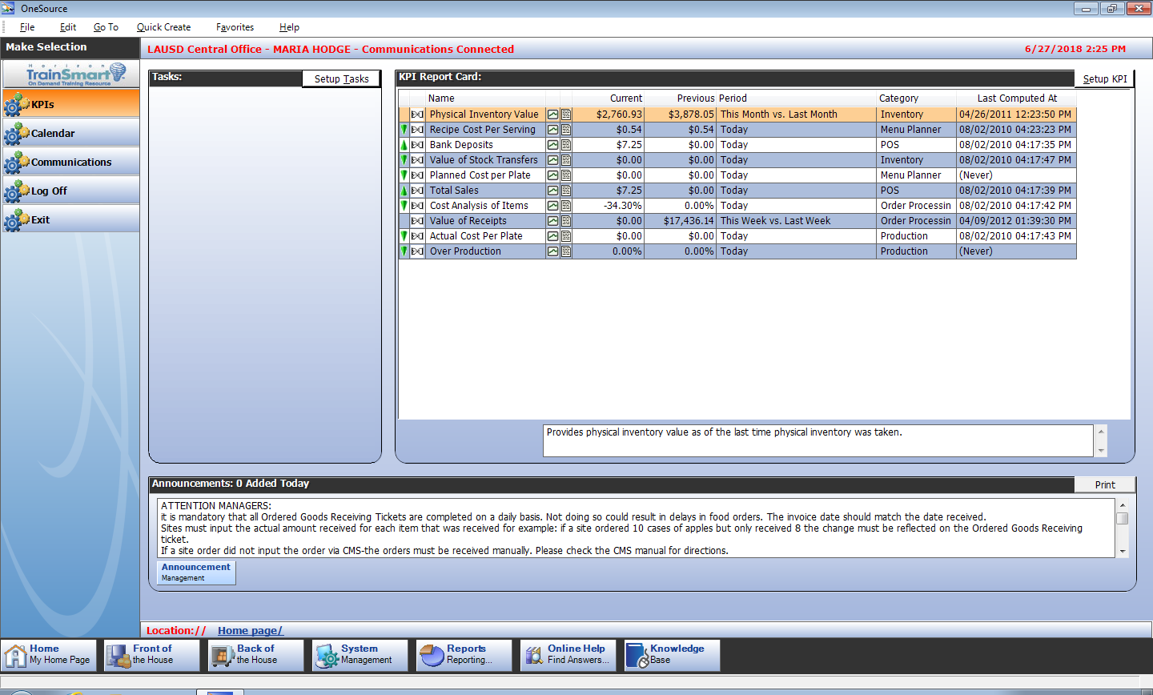
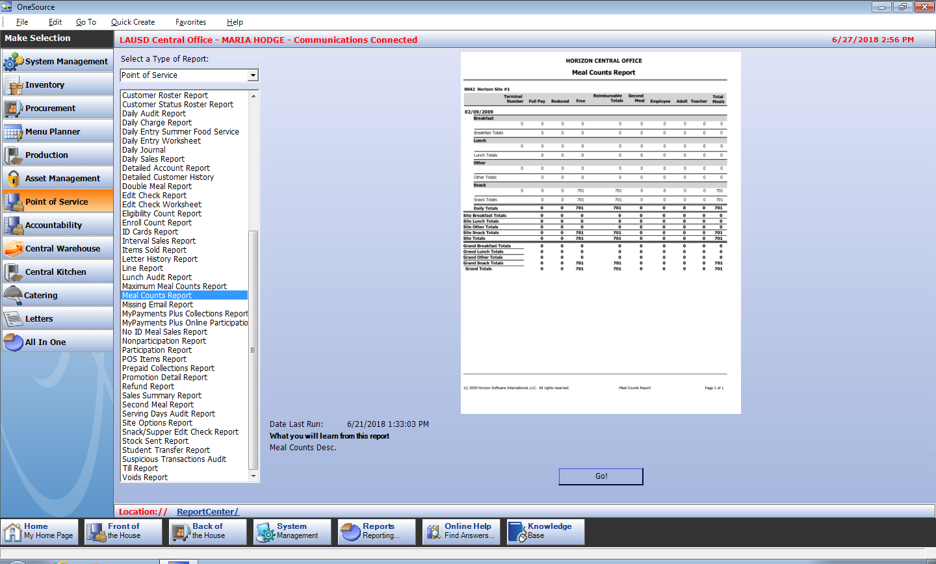
From Home page
Click Reports
From Reports
Click Letters
Notes:
Read Screen

Slide 13
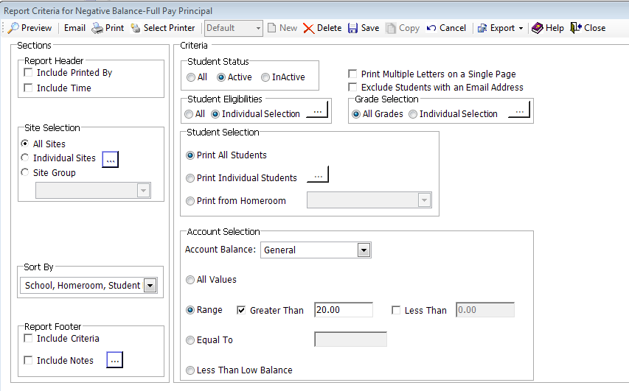
Must Always Be “Active”
Click on “Individual Selection” to select your searching criteria.
Select “All Grades”
Select “Print All Students”
For Manager’s Letter
If the account balance is less than - $20.00
For Principal’s letter
If the account balance is more than - $20.00
Notes:
Read Screen

Slide 14
Notes:
Preview will provide you with the letters for review before you print.

Slide 15
Questions?
Thank you!
LAUSD Food Services Division
Nourishing Children to Achieve Excellence
Notes:
Last page: Questions?

